Slide 1
Data Analysis Techniques
Ammar Alharbi
Detection of AI-Generated Arabic Text: A Data Mining Approach

Slide 2
Dataset Summary
We utilize a substantial dataset comprising 41949 Arabic research abstracts, which includes:
AI-generated abstracts produced using various large language models (LLMs)
Human-written abstracts
Abstract | Count
AI | 33552
Human | 8388

Slide 3
Dataset Preprocess
Method | Description
Reomve Diacrirics | Such as (damma, fatha, and kasra)
Normalize Arabic | Standardizing text such as (أ , إ , آ to ا )
Arabic Stopwords | Remove common word such as ( و , في , من)
Stemmer | Exracting base root of words such as (كاتب) the root is (كتب)

Slide 4
Feature Engineering
Feature | Description
Feature 16 | Related to the number of words that contain repeating letters
Feature 34 | Total number of sentences present in a given text
Feature 39 | The number of words divided by number of sentences that contain the word
Feature 62 | Number of sentences that don’t have a complete
Feature 85 | Different lengths of sentences from each other
Feature 108 | Number of polite words compared to total number of words

Slide 5
Results Model
AI
Model | Accuracy | Precision | Recall | F1-score
LR | 0.97 | 0.97 | 0.99 | 0.98
SVM | 0.98 | 0.99 | 0.99 | 0.99
RF | 0.98 | 0.99 | 0.99 | 0.99
FFNN | 0.84 | 0.85 | 0.97 | 0.91
Human
LR | 0.97 | 0.96 | 0.90 | 0.93
SVM | 0.98 | 0.96 | 0.96 | 0.96
RF | 0.98 | 0.97 | 0.98 | 0.97
FFNN | 0.84 | 0.75 | 0.36 | 0.49

Slide 6
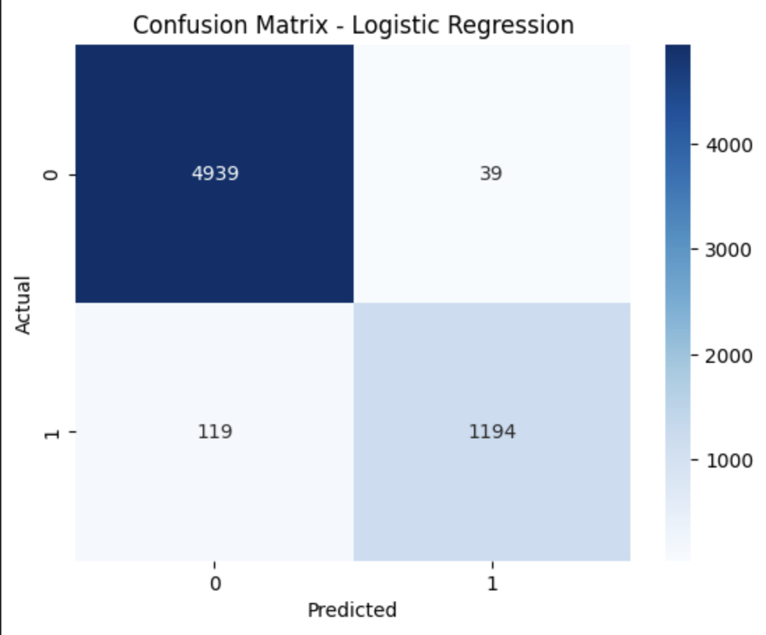
Confusion Matrix Logistic Regression
Total abstract for AI 4978:
classified correct is 4939, misclassified is 39
Total abstract for Human 1313:
classified correct is 1194, misclassified is 119

Slide 7
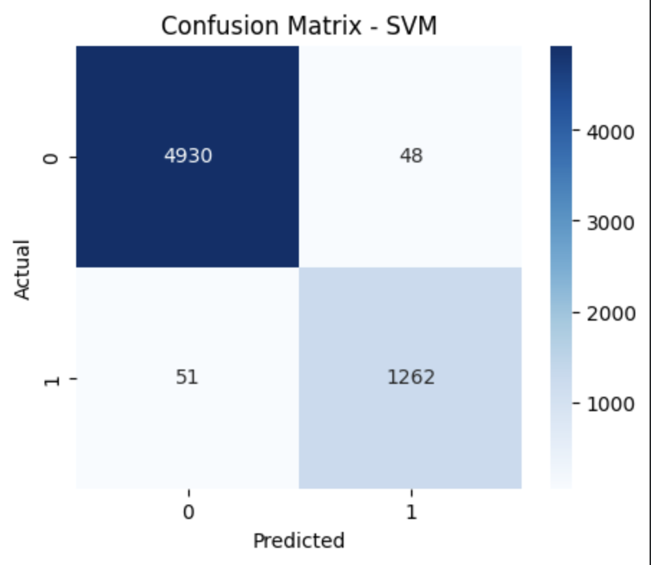
Confusion Matrix SVM
Total abstract for AI 4978:
Classified correct is 4930, misclassified is 48
Total abstract for Human 1313:
Classified correct is 1262, misclassified is 51

Slide 8
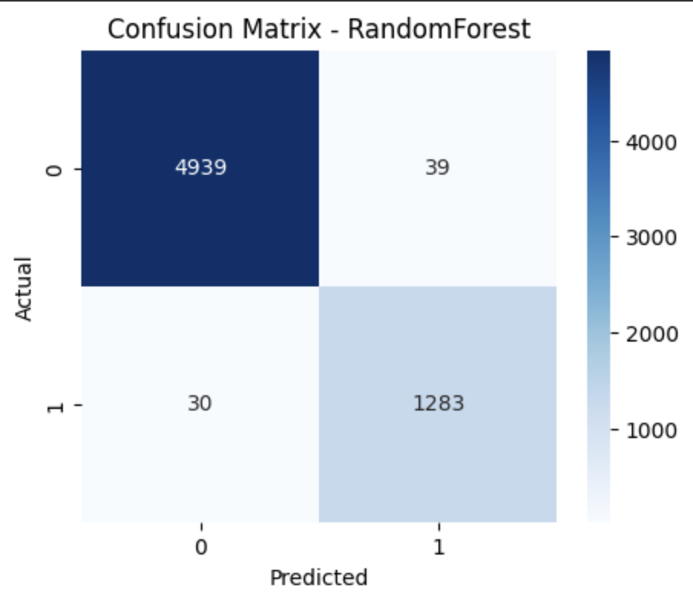
Confusion Matrix Random Forest
Total abstract for AI 4978:
classified correct is 4939, misclassified is 39
Total abstract for Human 1313:
classified correct is 1283, misclassified is 30

Slide 9
Analysis of Confusion Metrices
Model / AI | Classified Correct | Misclassified
Logistic Regression | 4939 | 39
SVM | 4930 | 48
Random Forest | 4939 | 39
f
Model / Human | Classified Correct | Misclassified
Logistic Regression | 1149 | 119
SVM | 1262 | 51
Random Forest | 1283 | 30

Slide 10
Analysis of Confusion Metrices
The Logistic model, SVM model, and Random Forest in this analysis are considered good, showing high performance in accuracy, precision, and recall metrics. However, the SVM model took longer time compared to the others.
When evaluating the performance of the Logistic Regression, it good according to AI, making it the preferred choice in this case.
Therefore, we can choose the Random Forest model, it good in both AI and human.

